Slide 1
RISe: Well-being & Resilience
Tanager Place

Slide 2
Foundational Concept
In the end, children succeed because they feel they have a close relationship with others, feel valued in their communities, and have a sense of control over some aspects of their lives; children who are in trouble feel isolated, useless to society, and powerless.
-A Teacher’s Guide to Understanding and Motivating Students

Slide 3
Relationships Indicators of well-being Social Emotional learning Enhance
https://www.youtube.com/watch?v=zdHFEkNZM9k

Slide 4
Relationships

Slide 5
Foundation
The healthy relationships we have with ourselves and others is the foundation required to actualize well-being and resilience.

Slide 6
Starts with a belief…
That there is no such thing as a bad kid.
All behavior communicates a need.
Everyone has greatness inside of them.

Slide 7
Let’s color together!!
https://www.youtube.com/watch?v=LmVWOe1ky8s

Slide 8
Private logic
External messages and experiences become our internal realities.
We learn patterns based on our environment.
How we see our self, others, and the world around us.

Slide 9
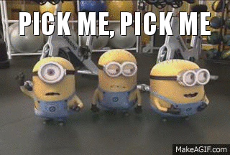
The YOU intervention
We can help kids build and cultivate well-being and resilience through first developing an authentic relationship with them, believing in their strengths and potential.

Slide 10
You can’t lead others past the point of your own healing…

Slide 11
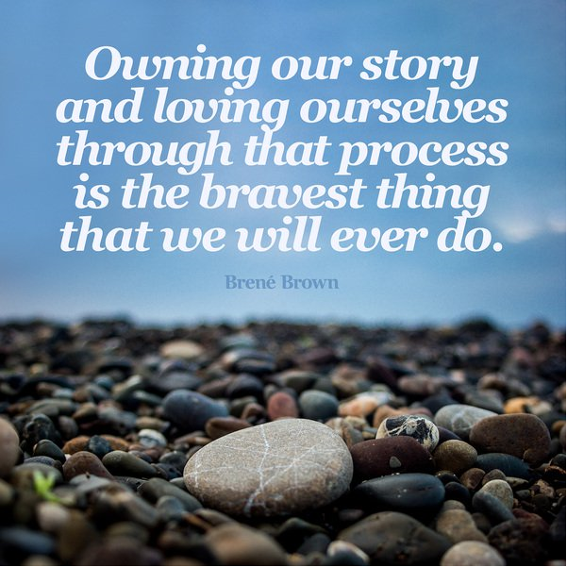
Assessing yourself – Importance
Why should we assess ourselves?
Self awareness is most important piece of our relationship puzzles
If you don’t know who you are, students will help you figure it out
Being open to who you are helps students be open to themselves
We are followed by our compassion and humility

Slide 12
Assessing yourself – The power of vulnerability
Brené Brown Resources:
https://www.ted.com/talks/brene_brown_on_vulnerability
I Thought It Was Just Me (But It Isn’t)
The Gifts of Imperfection
Daring Greatly
Rising Strong
Braving the Wilderness
Dare to Lead
Daring Classrooms https://brenebrown.com/daringclassrooms/
https://www.youtube.com/watch?v=DVD8YRgA-ck
The Call to Courage (on Netflix)

Slide 13
Assessing yourself – Assessment tools
Gallup Strengths Finder https://www.gallupstrengthscenter.com/home/en-us/strengthsfinder
Myers Briggs https://www.16personalities.com/free-personality-test
Colors Test https://365tests.com/personality-tests/free-color-personality-test/
Love Languages https://www.5lovelanguages.com/
Attachment Style https://dianepooleheller.com/attachment-test/
Compassion Fatigue and Satisfaction
Crucial C’s
Personality Priorities
Values Checklist

Slide 14
The pathway to better relationships…
Through knowing yourself and being aware of your needs, preferences and bias you are more likely to attune and connect with a child in a regulatory manner, helping the child meet their needs.

Slide 15
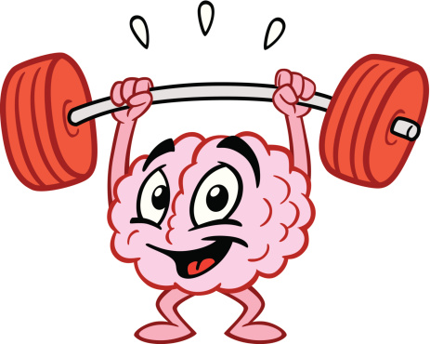
Foster resilience with the brain in mind

Slide 16
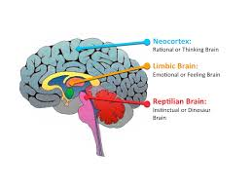
Let’s Speak the Same Language

Slide 17
Stop talking and listen
Remain in the right brain; just be present – don’t go to lecture, logic or reasoning
REGULATE YOURSELF
What are your sensations?
What are your emotions?
What are your thoughts or the story you are telling yourself?
Notes:
When children are in crisis, it is important to use the relationship you have, and use this opportunity to continue growing the relationship through attunement.

Slide 18
Tone of voice
Posture
Facial Expression
Gestures
Intensity of Response
Timing and Rhythm
Proximity
Touch
Notes:
You need to calm down, example of validate vs. harsh

Slide 19
Attunement:
Reflect what you hear
Once you’ve listened, reflect back what you’ve heard.
Reflection, paraphrasing, validation
Even when you don’t like the behavior, acknowledge and embrace feelings.
Notes:
When children are in crisis, it is important to use the relationship you have, and use this opportunity to continue growing the relationship through attunement.

Slide 20
Healing through relationships…
Through this process you give:
Insight
Help kids understand their own feelings and the responses to difficult emotions
Empathy
Give kids practice reflecting on how their actions impact others
Repair
Give gives ability to make things right and ability to problem solve.

Slide 21
Indicators of Well-being

Slide 22
Indicators of Well-being
Safety – physical, emotional, and mental safety; state in which conditions that could cause harm are controlled in order to preserve health and well-being; a sense of stability and security
Connection/Belonging – state in which a person is linked or associated with something else and experiences a sense of fitting in or feeling like they matter; we are hardwired for connection; we feel seen, heard, and accepted for who we really are
Meaning/Purpose – a state in which you feel a sense of direction, determination, and fulfillment; not “everything happens for a reason” but “in everything, I can find my meaning and purpose”
Efficacy – ability to achieve and feel a sense of self-actualization and mastery; have a sense of control within our world when others honor our thoughts, feelings, and perceptions; we feel capable and courageous

Slide 23
SAFETY

Slide 24
Stressed brains can’t learn!
https://www.kidsinthehouse.com/special-needs/other-disabilities-or-impairments/why-a-brain-under-stress-cant-learn-new-information
Safety is essential for learning!
Without safety, all of your hard work is for nothing…

Slide 25
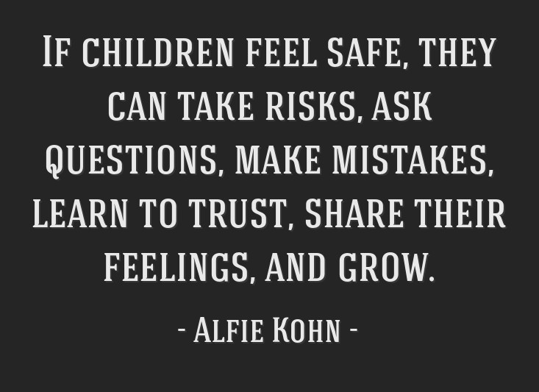
Creating Safety in the classroom
Interventions to utilize:
Basic needs met
I wish my teacher knew…
Check in’s
Consistency & Routine
Norms
Peace corners
https://www.mrsbeattiesclassroom.com/

Slide 26
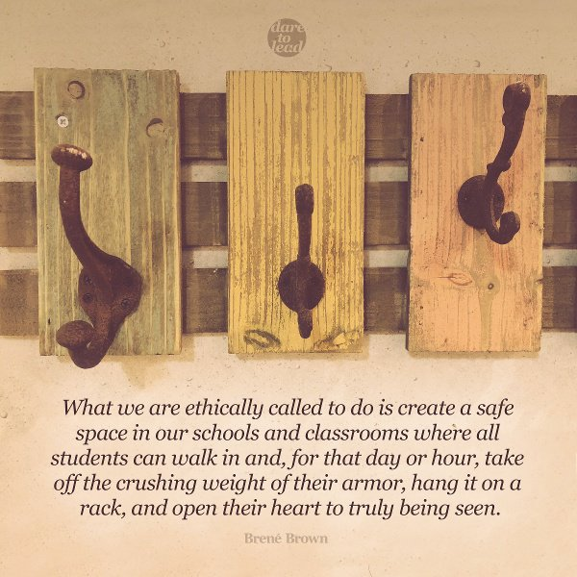
Turn – pair - share
Identify1-2 interventions you can utilize in your classroom or within relationships to create a sense of safety for kids.

Slide 27
Connection/ Belonging

Slide 28
Sweet caroline
https://www.bing.com/videos/search?q=sweet+caroline+youtube+red+sox&qpvt=sweet+caroline+youtube+red+sox&view=detail&mid=7F17BF7132CD528D96E07F17BF7132CD528D96E0&&FORM=VDRVRV
Why do so many Boston Red Sox fans react to this song in such a unified, positive way?
Why do others react to this song in such a unified, positive way?
Remember – we are hardwired for connection!

Slide 29
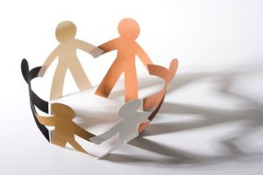
Creating connection and belonging in the classroom
Interventions to utilize:
Come up with a class theme song, mantra, chant, etc.
Get to know your students (those assessments are helpful)
Circles
Pair students with others intentionally to create connection
Allow for small group work
Hobbies/Clubs
Lunch groups
Strengths building

Slide 30
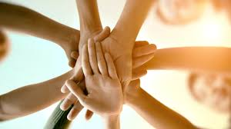
Turn – pair - share
Identify 1-2 interventions you can utilize in your classroom or within relationships to create a sense of connection/belonging for students.

Slide 31
Meaning/ purpose

Slide 32
The impact of purpose and meaning
https://www.youtube.com/watch?v=YHwTbONqxqE
Humans are hardwired for direction, purpose, finding meaning…
Help kids find their moments of meaning at school
You matter, we need you!
Servant leadership
Vision mapping
Practice gratitude
Give “jobs” in the classroom

Slide 33
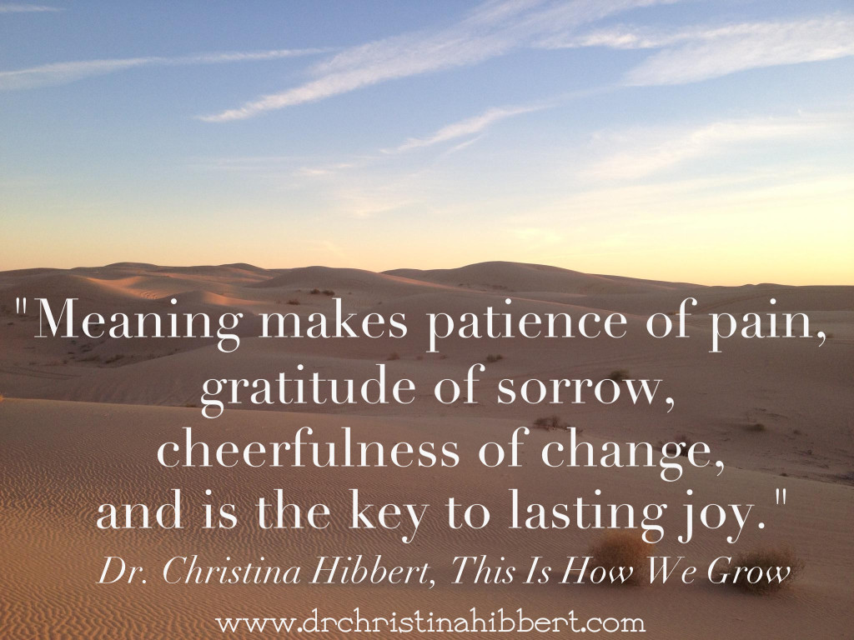
Creating meaning and purpose in the classroom
Interventions to utilize:
Practice gratitude
Give “jobs” in the classroom
Create diplomacy and community
Explore servant leadership
The science of mattering

Slide 34
Turn – pair - share
Identify 1-2 interventions you can utilize in your classroom or within relationships to create a sense of meaning/purpose for kids.

Slide 35
Efficacy

Slide 36
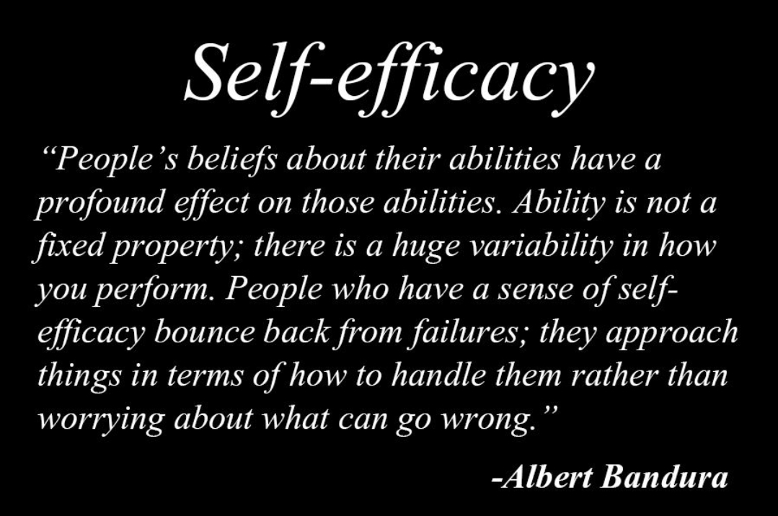
Creating Efficacy in the classroom
Interventions to utilize:
Encourage
Increase sense of capable by honoring efforts
Goal making
Mastery building
Highlight accomplishments - recognize successes and strengths!
Teach students about the brain

Slide 37
Turn – pair - share
Identify1-2 interventions you can utilize in your classroom or within relationships to create a sense of efficacy for kids.

Slide 38
Social Emotional Learning

Slide 39
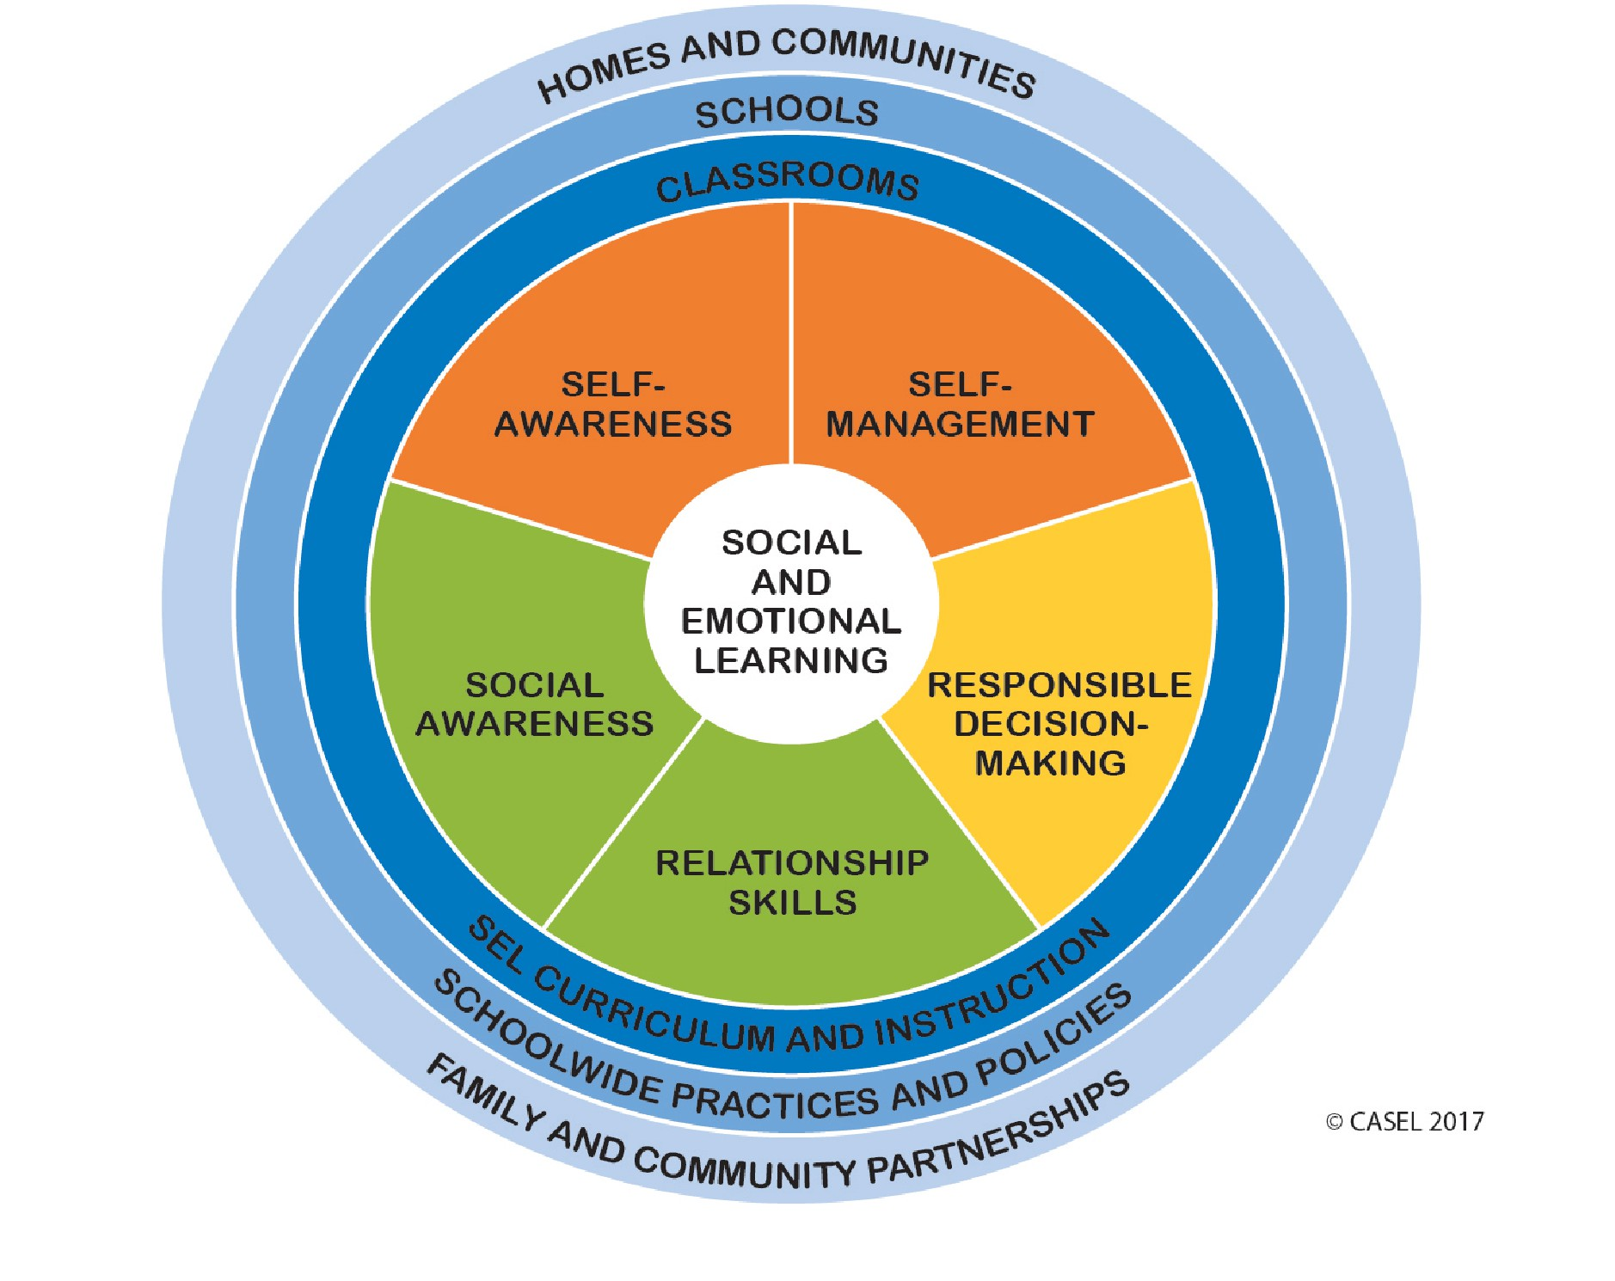

Slide 40
Enhance

Slide 41
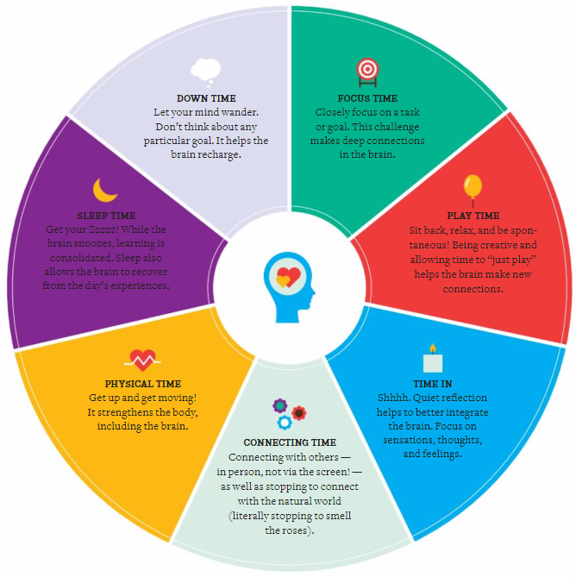
Dr. Siegel: Healthy Mind Platter

Slide 42
The good news - REPETITION
The number of times an intervention must be repeated can be frustratingly high. However, REMEMBER – parts of the brain can’t be changed unless they are activated. Sufficient repetition is the only way change will occur.
The process is long and requires PATIENCE.

Slide 43
The Karate Kid – Wax on Wax off
Notes:
Talk about clip or show clip
Option: “Show Paint the Fence” clip. Sufficient repetition is the only way change will occur. We have to repeat the intervention to create new pathways, or we can think of it as creating new “muscle memories.” In this clip, the main character Daniel is being trained by Mr. Miyagi to learn karate. Daniel believes Mr. Miyagi is just having him do chores, but he is teaching the foundational skills he needs to know. Sufficient repetition helped this foundation to become muscle memory, so he did not even need to think about doing the skills, his body already knew how to do them. We need to think this way about new interventions we are implementing, sufficient repetition is the only way change will occur and we want these skills to become like muscle memory so they do not even need to think about it, they know when to use them.

Slide 44
Daily Practices for YOU

Slide 45
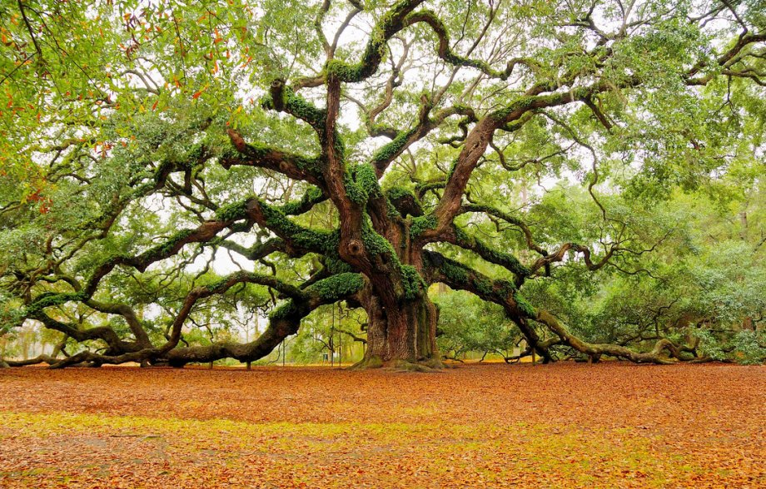
Spend Time in Self-Discovery

Slide 46
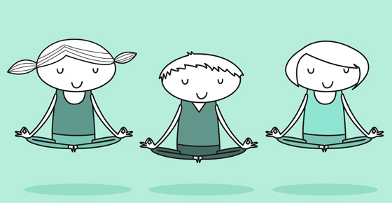
Practice Mindfulness

Slide 47
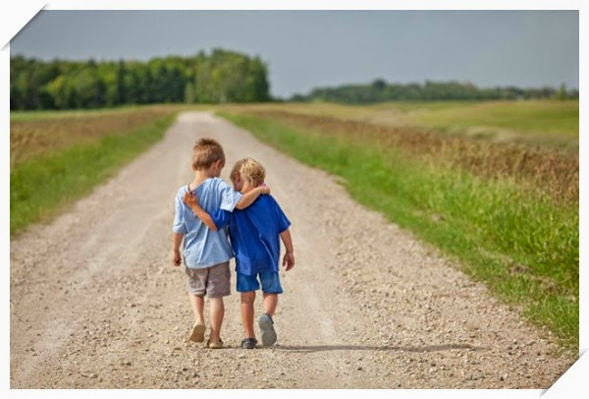
Practice Compassion and Empathy

Slide 48
Practice Gratitude, Humility and Altruism

Slide 49
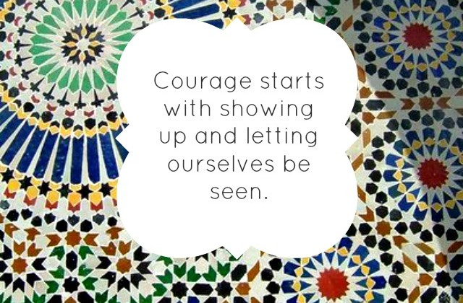
Practice Vulnerability and Authenticity

Slide 50
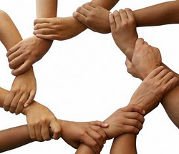
It Takes a Village & Give Yourself Grace
Hope springs from knowing we are not alone – find your village.

Slide 51
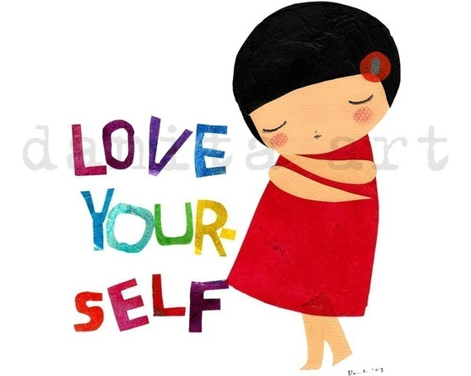
Develop a Self-Care Strategy

Slide 52
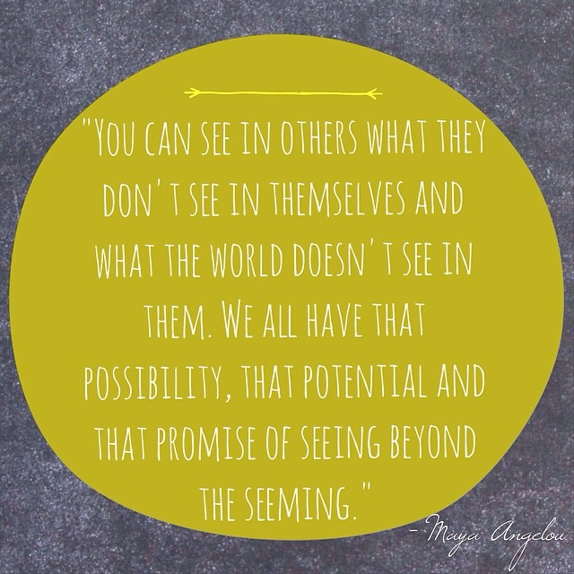
R
I
S
E
R
I
S
E
https://www.youtube.com/watch?v=A4QuKwfv6Wk

Slide 53
References and Resources
EMDR and Beyond
TLC – Trauma Loss in Children & Starr Global Network
Heather Forbes – Help for Billy
ACES 360
Adlerian Play Therapy; Dr. Terry Kottman
CASEL
Dr. Dan Siegel
Parenting From the Inside Out
The Whole Brain Child
Mindsight
No Drama Discipline

